Slide 1

AI and Big Data for Fraud Detection in Financial Systems
This presentation outlines our project using AI and big data techniques to detect financial fraud efficiently and accurately.
Bo Yu 1194159
Notes:
Hello everyone!
Thank you for joining me today. I am Aiden, and I’ll walk you through my project on using AI and big data to fight financial fraud. Let’s start with why this matters.

Slide 2

Project Introduction
Challenge
Objective
Online fraud is increasing rapidly in financial sectors.
Develop an AI-based system to detect fraud within large datasets.
Technologies
Python, MySQL, UML, OO Design, Real Kaggle Data
Notes:
In today’s digital world, millions of online transactions occur every day—including online shopping, banking, and payments. However, as digital systems grow, so do security risks. Online fraud has increased significantly in recent years, with someone using advanced techniques to steal personal and financial information. This not only causes major financial losses for businesses and individuals, but also damages customer trust.
The aim of this project is to develop an intelligent fraud detection system that can quickly and accurately identify suspicious transactions. The system is designed to act as an early warning mechanism—like a digital security guard.
To achieve this, we use real-world credit card transaction data from Kaggle. We apply machine learning techniques, specifically Random Forest models.
All data is stored and managed using MySQL, while Python is used for data preprocessing, model training, and evaluation. UML diagrams are used to model the system behavior and interaction.

Slide 3
System Requirements & Analysis
Main Functions
User Roles
Manage transaction data
Normal User: Upload and review data
Detect fraudulent activity
Admin: System management and model updates
Display fraud reports to users
Requirements focus on speed, security, and extensibility.
Notes:
This system is designed to manage transaction data, detect fraudulent activities, and generate fraud reports for users. It supports two roles:
Normal Users can upload transaction data and review analysis results.
Admins oversee system operations, update fraud detection models, and ensure security.
The design ensures efficient, secure, and scalable fraud detection for financial workflows.

Slide 4
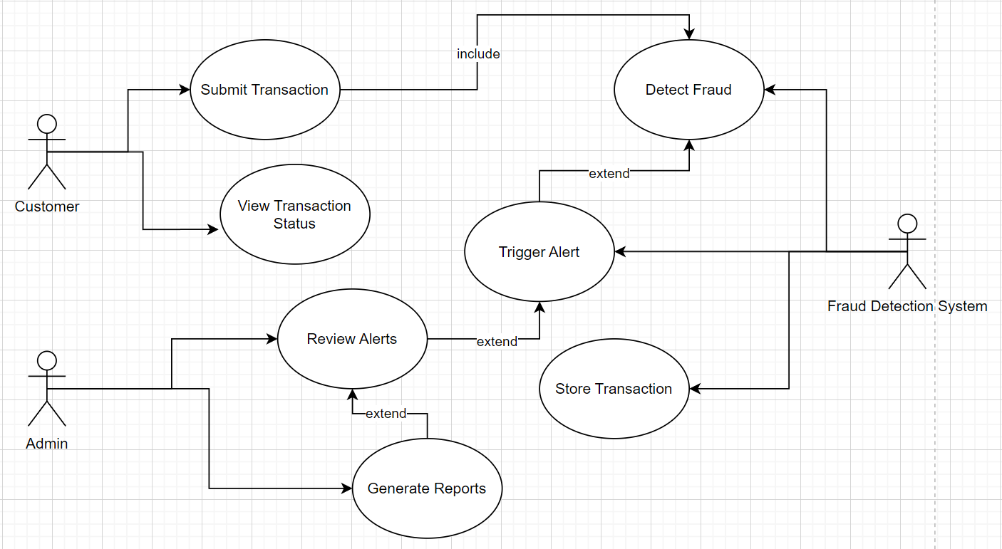
System Design: Use Case Diagram
This diagram outlines a transaction processing system where a Customer submits a transaction, triggering automated fraud detection. If risks are identified, the system triggers alerts for manual review by administrators. Validated transactions are stored and used to generate reports, while customers can view real-time status. The workflow balances automation (fraud checks, storage) with human intervention (alert handling), ensuring security and data integrity.
Notes:
IN This diagram:
Customer submits a transaction, which includes mandatory fraud detection.
Detect Fraud may extend to trigger an alert if suspicious activity is found.
Post-detection, the system extends to store the transaction and generate reports for analysis.
Customers can view transaction status, while admins review alerts to resolve risks.
Key Logic: Combines automated checks (fraud detection) with optional steps (alerts, reporting) based on results, ensuring security and transparency.

Slide 5
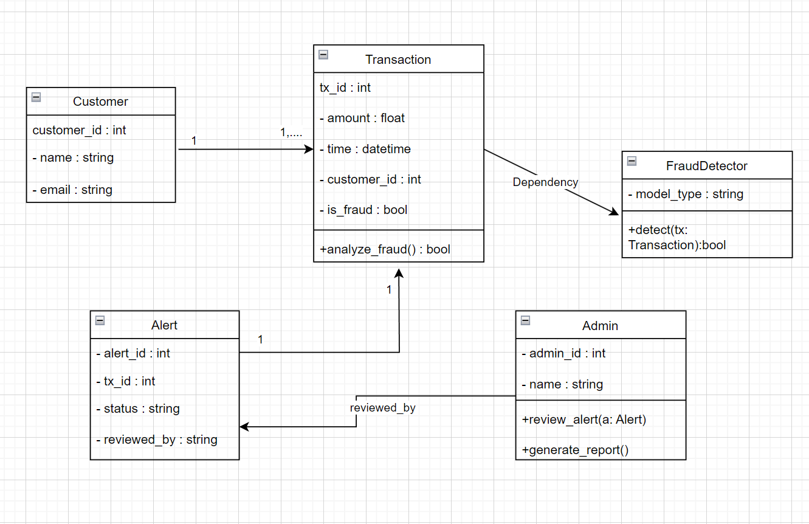
System Design: Class
This diagram models a transaction fraud detection system. The Transaction class stores transaction details (e.g., amount, time) and includes a method to analyze fraud risk. The FraudDetector class uses a model to detect fraud in transactions (detect()). If fraud is suspected, an Alert is created, which administrators (Admin) review and resolve. The Customer class holds user data linked to transactions. Admins also generate reports (generate_report()). The design emphasizes modularity, separating fraud detection logic, transaction handling, and administrative actions for scalability and clarity.
Notes:
The Transaction class stores transaction details (e.g., amount, time) and includes a method to analyze fraud risk. The FraudDetector class uses a model to detect fraud in transactions (detect()). If fraud is suspected, an Alert is created, which administrators (Admin) review and resolve. The Customer class holds user data linked to transactions. Admins also generate reports (generate_report()). The design emphasizes modularity, separating fraud detection logic, transaction handling, and administrative actions for scalability and clarity.

Slide 6
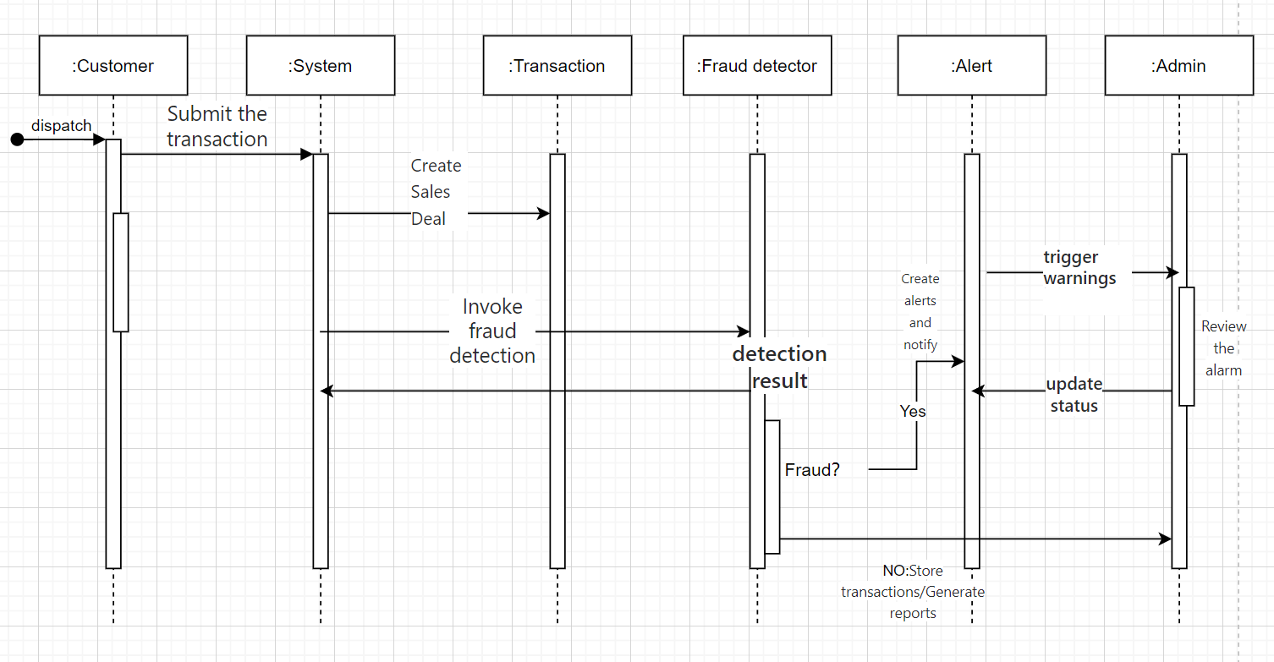
System Design: Sequence Diagrams
This flowchart outlines the transaction handling workflow:
A customer submits a transaction, triggering the system to create a sales deal and invoke the fraud detector for risk analysis.
The fraud detector evaluates the transaction:
Fraud detected (Yes): The system generates an alert, notifies the admin to review and update its status (e.g., block the transaction).
No fraud (No): The transaction is stored and a report is generated for analytics.
Closed-loop control: Alert resolutions feed back into the system, ensuring traceability and data consistency.
Notes:
This diagram shows the workflow of a fraud detection system:
A customer submits a transaction, prompting the system to create a sales deal and activate the fraud detector for risk analysis.
The fraud detector checks for fraud:
If fraud is detected (Yes): The system triggers an alert, notifies the admin to review it, and updates the status (e.g., block the transaction).
If no fraud (No): The transaction is stored, and a report is generated (e.g., sales summaries).
Feedback loop: Alert resolutions are sent back to the system.

Slide 7

Database Design
Designed using MySQL Workbench with a table supporting detailed transaction attributes.
The core table of the database FraudDetectionDB, CreditCardTransactions, stores transaction time (time_sec),
amount (amount), anonymous characteristics (v1-v10), and fraud labels (class). Primary key auto-increment (id) optimizes
query efficiency.
The data is derived from the Kaggle credit card dataset. After random sampling and label balancing,
it is automatically imported through Python scripts, supporting the training of fraud detection models and
real-time analysis. The design takes into account both privacy compliance and scalability.
Notes:
Our project uses a relational database to manage transaction data and fraud alerts.
The main table, CreditCardTransactions1, stores each transaction’s time, amount, and 10 anonymized features (v1 to v10), along with a class label that shows if it’s normal or fraudulent. This structure supports machine learning analysis and model prediction.
To handle suspicious activity, we created an Alerts table. When the system detects fraud, it adds a new alert with the transaction ID, message, timestamp, and status. Each alert is linked to a transaction using a foreign key.
This design follows object-oriented analysis principles. It clearly separates entities—transactions and alerts—and defines their relationships. The data from the Kaggle credit card dataset. After random sampling and label balancing,
it is automatically imported through Python scripts, supporting the training of fraud detection models and
real-time analysis.

Slide 8

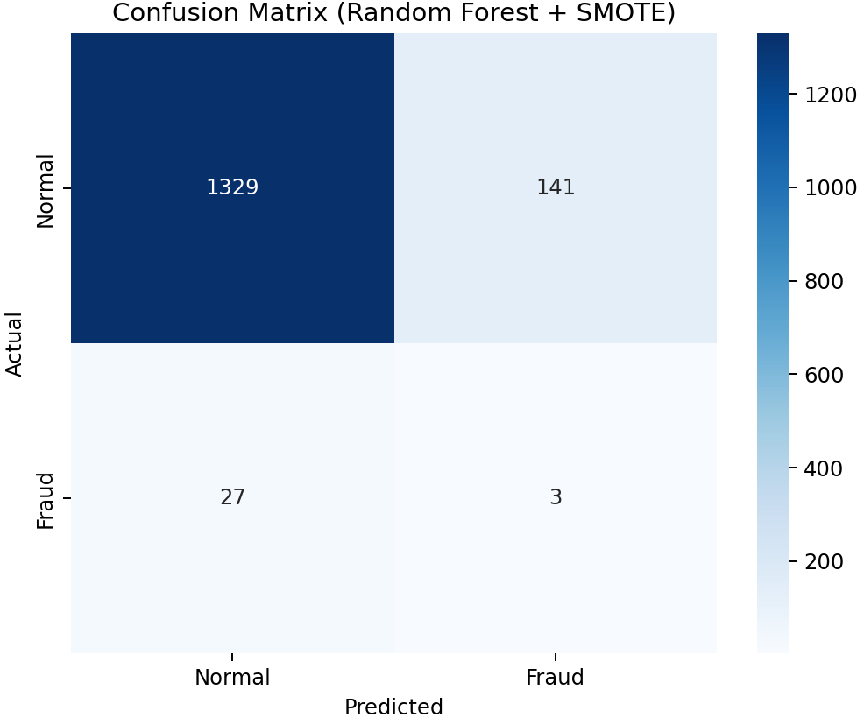
Model & Results
- Model Used: RandomForestClassifier (n_estimators=100, max_depth=10)
- Data Strategy: SMOTE used to oversample minority class (class=1)
- Feature Scaling: StandardScaler applied to normalize input features
- Accuracy: 88.8%
- Macro Average F1-score: 0.49
- Weighted Average F1-score: 0.92
Confusion matrix for classification validation
Notes:
Model Explanation
We used a Random Forest model to detect fraud. This model works like a team of experts voting on whether a transaction is suspicious. To handle the rare fraud cases (only 5% of data!), we balanced the dataset using SMOTE, which creates synthetic fraud samples. We also scaled transaction amounts and other features to ensure fairness in the AI’s decisions.
Results & Next Steps
The model achieved 88.8% accuracy, showing strong performance in identifying normal transactions. However, detecting fraud remains challenging (F1-score: 0.49), meaning some fraud cases are missed. To improve, we plan to enhance the AI’s fraud detection skills and add real-time alerts for faster responses. This system is a solid foundation for safer financial transactions.

Slide 9

Conclusion & Future Work
Achievements
This project implemented a fraud detection system using machine learning
and real financial data from SQL database.
Modeled key entities like Transaction, Detector, and Alert using UML
diagrams (Use Case, Class, Sequence).
The model (Random Forest + SMOTE) achieved 88.8% accuracy, showing
solid performance in identifying normal transactions.
Future Work
Add real-time detection component with streaming data.
Provide an interactive user dashboard for admin alerts and transaction
review.
Refactor system into fully object-oriented code (e.g., Python classes
for each component) to further align with OOAD principles.
Notes:
To conclude, this project successfully built a fraud detection system that combines machine learning with real transaction data. We used Python for modeling, MySQL for data management, and applied object-oriented analysis to structure the system. The model achieved high accuracy in detecting normal transactions, and the database was designed to support alerts and future extensions.
In the future, we plan to enhance the system with real-time fraud detection using streaming data, and provide an interactive dashboard for administrators to review and manage alerts. We also aim to refactor the code into a fully object-oriented structure, with clear classes for transactions, alerts, and users.

